Slide 1
Labradoodle or Fried Chicken?
Group 12
Han Cui, Jiwen You, Jingjing Feng, Yaqing Xie, Kanghui Jiang

Slide 2
SIFT + GBM
Feature: 2000*5000 SIFT data set
Model: Gradient Boosting Machine
Default Parameter Setting:
Interaction.depth <- 6
N.trees <- 1000
Shrinkage <- 0.01
Running time (1600 training data): 10 mins
Accuracy (400 testing data): 72.3%

Slide 3
SIFT + Feature Selection + GBM
Feature Selection Methods:
Set Variance Cut off Value: remove the features with low variance
Principle Component Analysis
Random Forest
Method | Selection Criteria | Selected Features | Running Time (1600 training data) | Accuracy (400 testing data)
Set Variance Cut Off Value | Drop the features with variance less than 0.5e-6 | 1968 | 4 mins | 71.3%
PCA | Keep 90% of the total variance | Roughly 750 | 2 mins | 72%
Random Forest | Select features based on their importance (13mins) | 750 | 1.5 mins | 64.5%

Slide 4
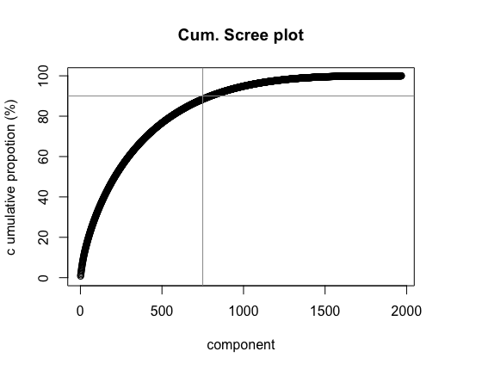

Slide 5
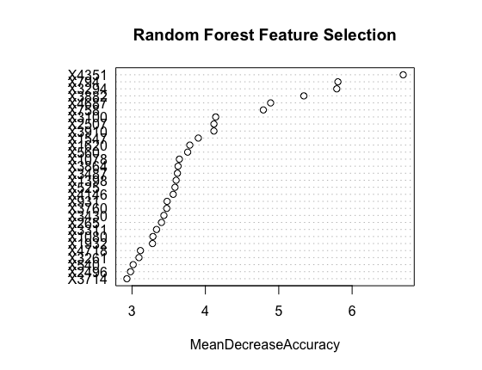

Slide 6
Model Construction
Gradient Boosting Machine
SVM
Logistic Regression
Xgboost

Slide 7
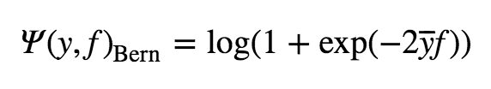

Gradient Boosting Machine
Loss function for categorical response
Bernoulli loss function
Adaboost loss function
Base learners: Decision Tree
Shrinkage: The learning rate applied to each tree during the expansion
Interaction.depth: The maximum number of splits
N.trees: The number of iterations

Slide 8
SIFT + PCA + GBM (Bernoulli)
Tuning Parameters & 5 folds Cross Validation
Distribution: Bernoulli (logistic regression for 0-1 outcomes)
Shrinkage: (0.0001, 0.0005, 0.001, 0.01)
Interaction.depth: (3, 5, 7, 9)
N.trees: (500, 1000, 1500, 2000, 4000)
Shrinkage | Interaction.depth | N.trees | Combination | Training Time | Accuracy
0.01 | 3 | 4000 | 80 | 12 hours | 70.3%

Slide 9
SIFT + PCA + GBM (Adaboost)
Tuning Parameters & 5 folds Cross Validation
Distribution: "adaboost" (exponential loss for 0-1 outcomes)
Shrinkage: (0.0005, 0.001, 0.01, 0.05)
Interaction.depth: (3, 5, 7, 9)
N.trees: (500, 1000, 1500, 2000, 4000)
Shrinkage | Interaction.depth | N.trees | Combination | Training Time | Accuracy
0.05 | 7 | 1500 | 80 | 12 hours | 71.5%

Slide 10

SIFT + PCA + SVM
Tuning Parameters & 5 folds Cross Validation
Kernel: Gaussian radial basis function
Gamma: The parameter of a Gaussian Kernel
(0.0001, 0.001, 0.01)
Cost: Trade off misclassification of training examples against the decision surface
(0.01, 0.1, 1, 5, 10, 50, 100, 200, 500)
Gamma | Cost | Combination | Training Time | Accuracy
0.0001 | 200 | 27 | 8 hours | 69%
Notes:
A small gamma implies the class of this support vector will have influence on deciding the class of the vector x_i even if the distance between them is large. If gamma is large, then variance is small implying the support vector does not have wide-spread influence. Technically speaking, large gamma leads to high bias and low variance models, and vice-versa.
A low C makes the decision surface smooth, while a high C aims at classifying all training examples correctly by giving the model freedom to select more samples as support vectors.

Slide 11
SIFT + PCA +Logistic Regression
Logistic regression with Stochastic Gradient Descent (SGD) training
SGD: Efficient approach to discriminative learning of linear classifiers under convex loss functions such as SVM and logistic regression
5 folds Cross Validation
Running Time | Accuracy
20s | 65%

Slide 12
SIFT + PCA + Xgboost
Xgboost is short for eXtreme Gradient Boosting package
It is generally over 10 times faster than the classical gbm
Tuning Parameters & 5 folds Cross Validation
eta: learning rate
max_depth: maximum depth of a tree
max_delta_step: maximum delta value allowed for each tree’s estimation
subsample: subsample of the training dataset
sclae_pos_weight: control for positive and negative weights
min_child_weight: minimum number of cases in each node
eta | max_ depth | max_delta _step | subsample | sclae_pos _weight | min_child _weight | Combination | Training time | Accuracy
0.01 | 8 | 1 | 0.8 | 1 | 6 | 480 | 6 hours | 71.3%

Slide 13
Base Model
Model | Training Time (5 folds CV) | Parameter Combination | Accuracy
GBM (Bernoulli) | 12 hours | 80 | 70.3%
GBM (Ada boost) | 12 hours | 80 | 71.5%
Support Vector Machine | 8 hours | 27 | 69%
Logistic Regression | 20s (no cross validation) | 0 | 65%
Xgboost | 6 hours | 480 | 71.3%
SIFT + PCA + Xgboost

Slide 14
Advanced Model – Feature Extraction
Method: Convolutional Neural Network
Python Package: nolearn, lasagne, caffe
Nolearn & Lasagne
CNN structure: conv1 + pooling1 + conv2 + pooling2 + dropout1 + dense + dropout2
Feature Extracted: conv2, polling2
Result: Long feature extraction time
Caffe:
Layer structure: norm + conv + pool + fc + prod

Slide 15
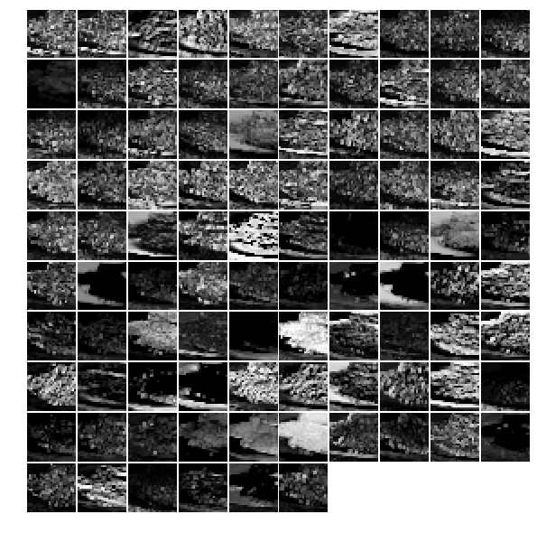
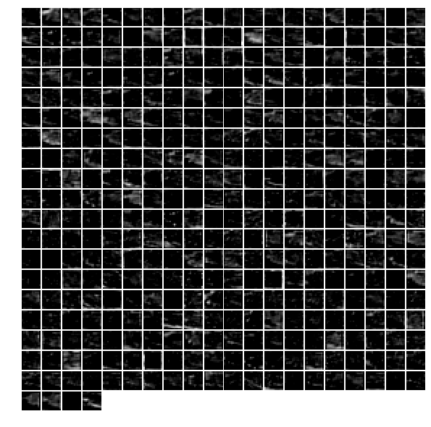
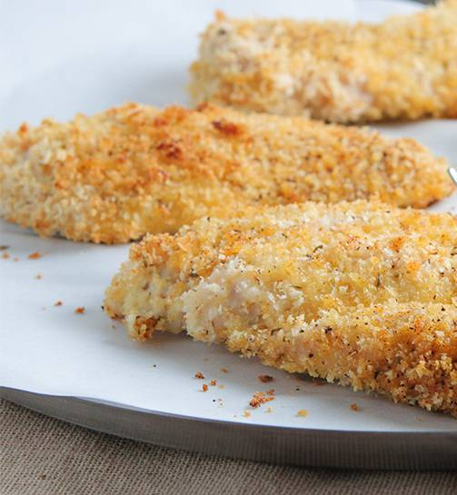
Advanced Model – Feature Extraction
Norm1 layer
Conv3 layer
Caffe Feature Extraction

Slide 16
Advanced Model
Layer (around 10mins) | Total Features | Features Selected | PCA: Total variance of Explanation | Logistic Regression Testing Accuracy (5 Folds CV)
norm1 | 69984 | 1200 | 91% | 86.75%
norm2 | 43264 | 1200 | 91% | 91.00%
conv3 | 64896 | 1200 | 90% | 91.75%
conv4 | 64896 | 1200 | 90% | 93.50%
conv5 | 9216 | 1500 | 94% | 93.25%
pool5 | 43264 | 1000 | 91% | 94.00%
fc6 | 4096 | 900 | 91% | 96.25%
fc7 | 4096 | 1000 | 96% | 96.50%
fc8 | 1000 | 1000 | 100% | 95.50%
prob | 1000 | 1000 | 100% | 94.00%
Notes:
Time consideration
Logistic regression model is widely used in deep learning

Slide 17
Model Testing
Caffe + PCA + Xgboost + Layer Norm1 & Conv3:
9 hours training
95% accuracy
Scraping 2000 pictures from the internet
Advanced model: Caffe + PCA + Logistic Regression
Layer | Testing Accuracy | Layer | Testing Accuracy
Norm1 | 86.00% | Pool5 | 95.05%
Norm2 | 87.20% | Fc6 | 94.75%
Conv3 | 93.00% | Fc7 | 95.25%
Conv4 | 94.00% | Fc8 | 95.30%
Conv5 | 94.20% | Prob | 93.30%

Slide 18
Summary
Base Model：SIFT + PCA + Xgboost
Training time: 6 hours
Accuracy: 71.3%
Advanced Model：Caffe + PCA + Logistic Regression + Layer Norm1 & Conv3
Feature Extraction + training time: 20 mins
Accuracy: 91.75%
Note: run as man layers as possible if time allows. The accuracy can be raised to roughly 96%.

Slide 19
Future Improvement
Try more models for the Caffe Feature dataset
Find the similarities among the pictures which are misclassified
Consider the overfitting problem

Slide 20
Thank you!
Group 12
Han Cui, Jiwen You, Jingjing Feng, Yaqing Xie, Kanghui Jiang

